Slide 1
Sharks in Trees
Boosted Regression Tree Analysis of Acoustic Telemetry Data
Charles Bangley
Dalhousie University
Brian Skerry

Slide 2
Disclaimer
Ecologist
Statistician
Photo credit: Cecilia Krahforst

Slide 3
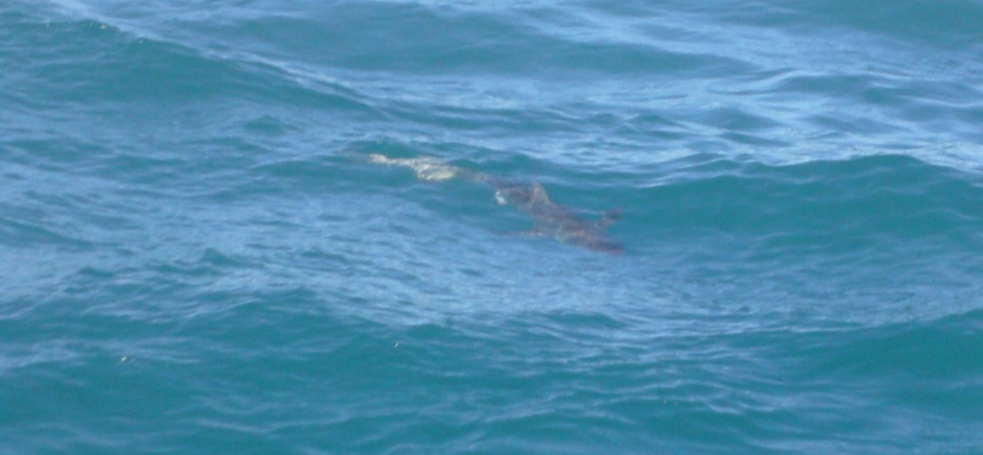
Overview
BRT Basics
A Brief (Likely Incomplete) History of BRT Analysis in Shark Research
Using BRTs with Acoustic Telemetry Data
BRT Analysis in R using gbm.auto
Case Study (and Shameless Paper Promotion): NW Atlantic Dusky Sharks

Slide 4
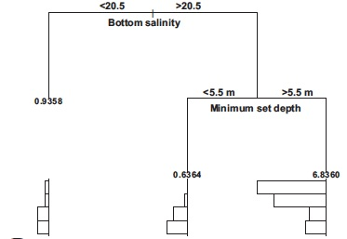
BRT Basics
Regression Tree Analysis
Splits data into branches (or nodes) at cut points in explanatory variables
Splits aim to minimize variance in the resulting branches
Usually between high and low values of the response variable
Results provide ranges of explanatory variables associated with high response variable values
Grubbs and Musick (2007)

Slide 5
BRT Basics
Boosting
Reduces variance in individual regression tree analysis
Boosting – repeats analysis over many iterations
Machine learning allows each successive tree to “learn from” the last
Process repeated over many iterations until deviance between trees is minimized – typically at least 1000
Grubbs and Musick (2007)

Slide 6
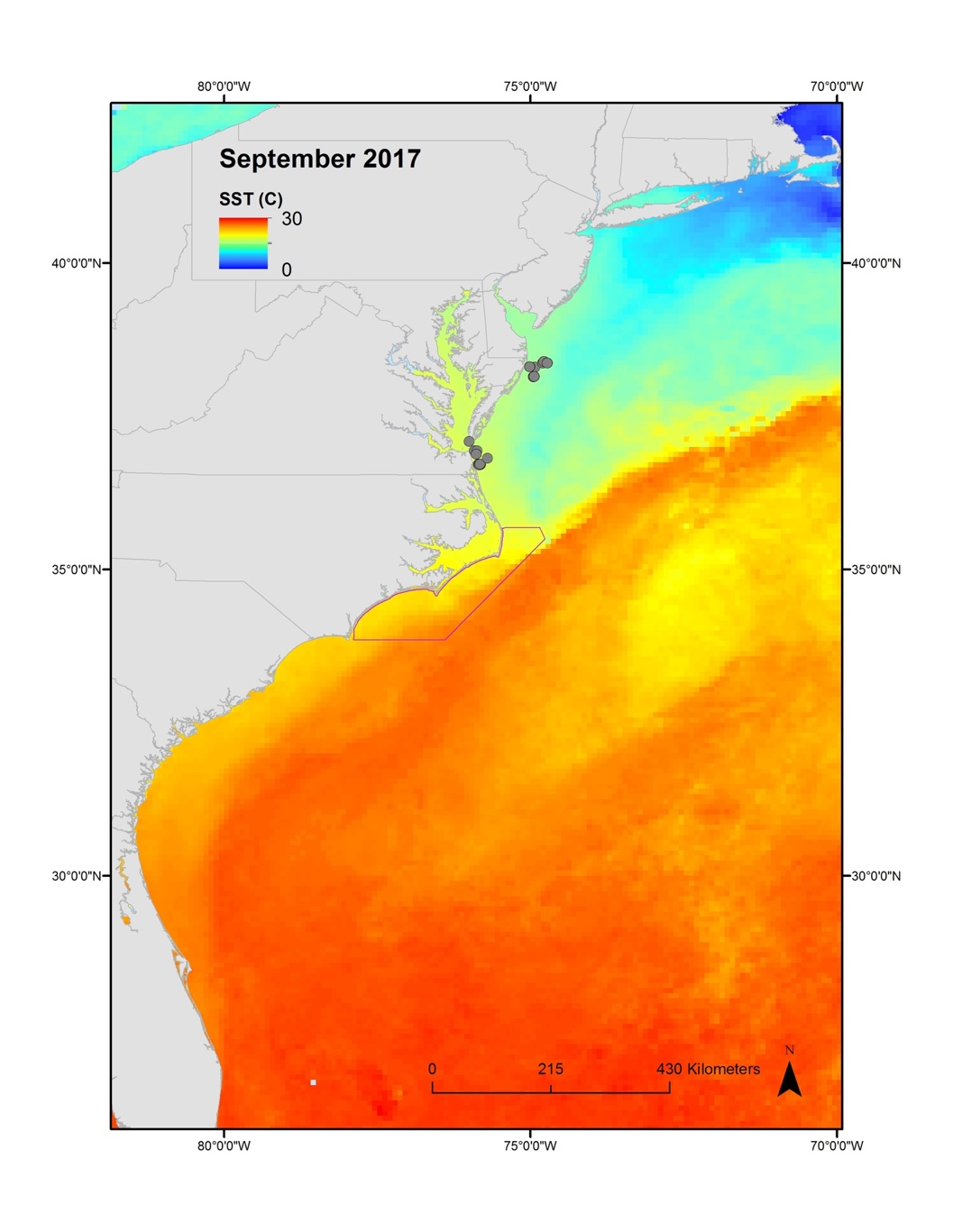
BRT Basics
Response Variables
Presence – binary/probability
Abundance – Gaussian
Can model each separately or both
Abundance corrected for presence probability
Explanatory Variables
Environmental data
Presence/abundance of other species

Slide 7
BRT Basics
Model Parameters
Tree Complexity (tc) – number of nodes at each split
Typically either two or number of explanatory variables (within reason)
Learning Rate (lr) – contribution of each tree to reducing deviance of the next
Bag Fraction (bf) – proportion of data randomly selected and used to cross-validate the rest (the training data)
Usually 0.4-0.7
Data are randomly selected for each tree iteration

Slide 8
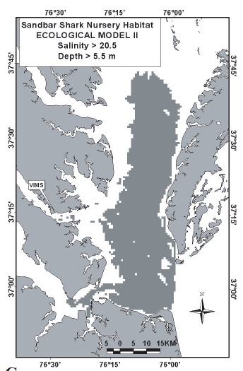
BRT Basics
Spatial Analysis – mapped BRT results are very intuitive (and look really cool)
Applies model results to grid of environmental data
Grubbs and Musick (2007)

Slide 9
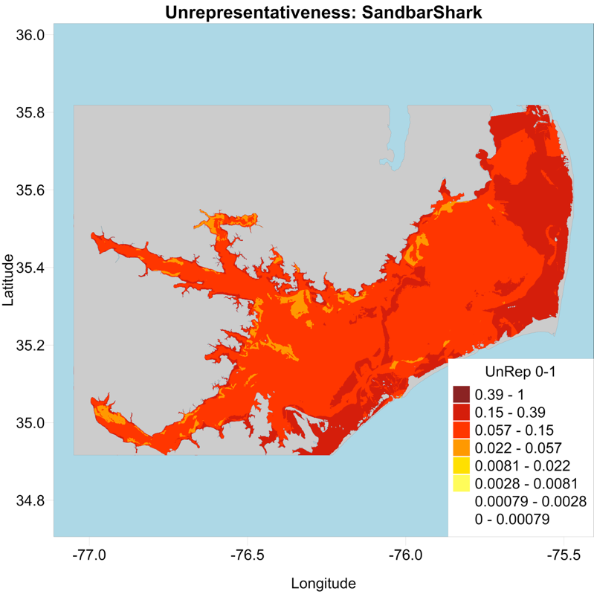
BRT Basics
Model diagnostics – no p-value, so how do you (and/or reviewers) know how well it performed?
Cross-validation score (CV score) – the greater, the better
0.6 or greater considered “good”
Area Under Curve (AUC) – the greater, the better
Mean Deviance – the lesser, the better
Unrepresentativeness Maps (for spatial analysis)
Shows how well data used in the model overlap with the actual range of explanatory variables in environmental grid
Cross-validated AUC vs. training data AUC
Used to measure model overfitting – not significant if values are similar

Slide 10
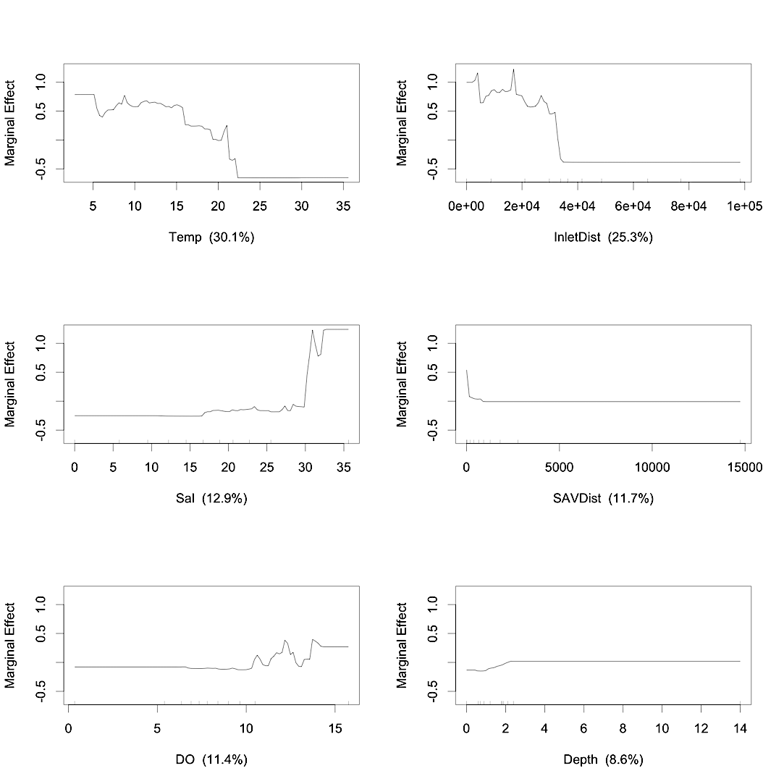
BRT Basics
Marginal Effect Plots – Provide information on:
Relationship with each explanatory variable
Line height shows positive/negative effect
Y-axis is relative probability for binary models, deviation from mean for Gaussian
Relative importance/influence of each explanatory variable
Measured as % of tree splits attributed to that variable

Slide 11
BRT Analysis and Shark Research
BRT models handle unusual data distributions and zero-inflated data well
Common issues working with highly migratory and/or data-poor species
Typically at least 20 presence records are needed
Sometimes possible to model presence but not abundance

Slide 12
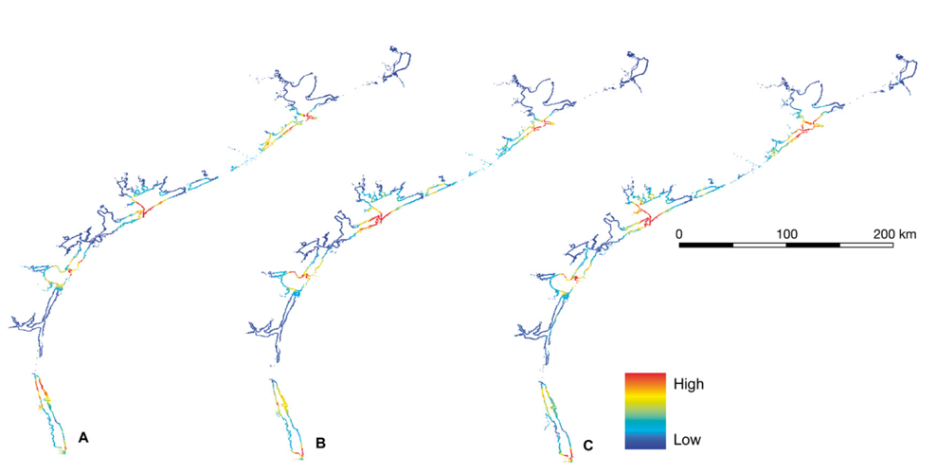
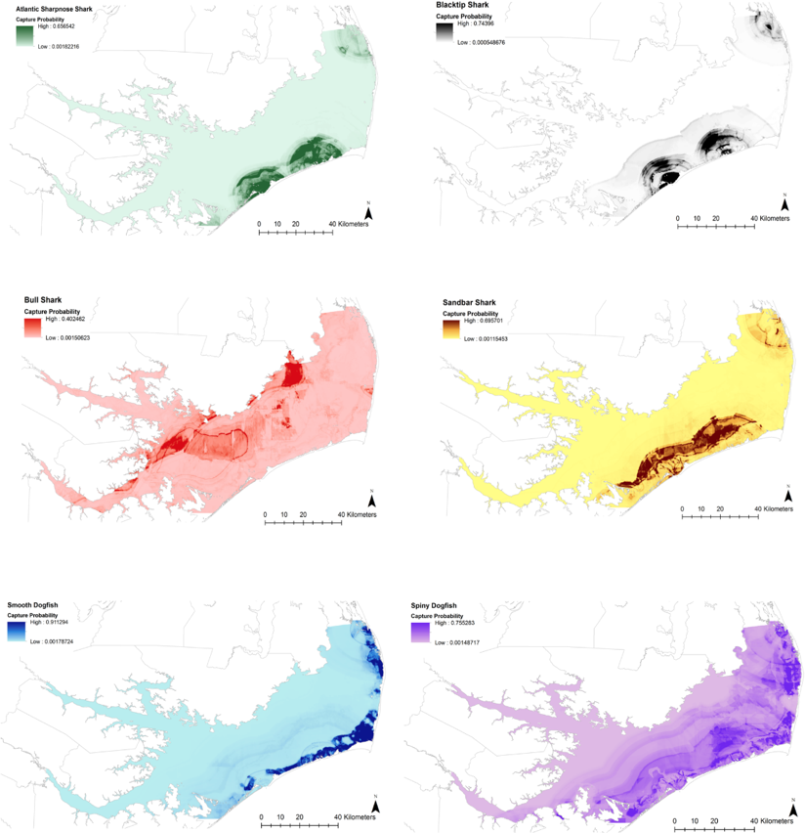
BRT Analysis and Shark Research
Usually used to model survey catch data
Grubbs and Musick (2007)
Bangley et al. (2018)
Froeschke et al. (2010)

Slide 13
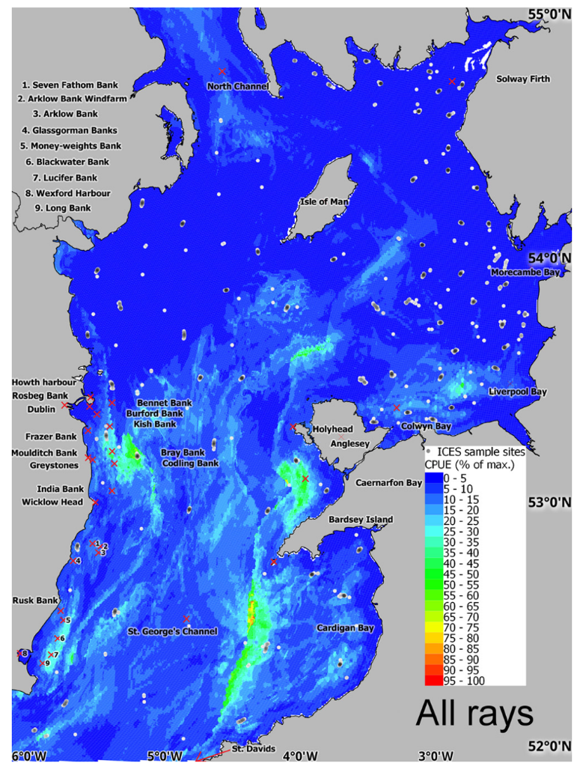
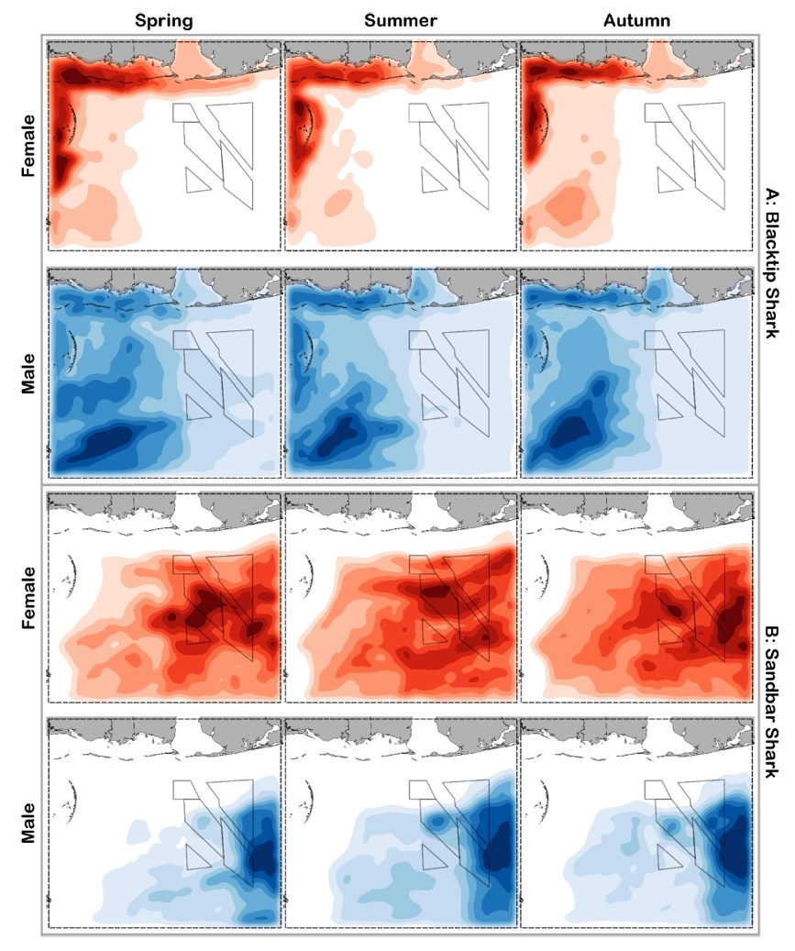
BRT Analysis and Shark Research
Assessment of spatial conservation/management policies
Dedman et al. (2015)
Drymon et al. (2020)

Slide 14
BRT Analysis and Acoustic Telemetry
Variables from acoustic telemetry data
Response Variables
Presence – detection at a given receiver over a certain time
Presence/absence per day, hour, etc.
Abundance – usually requires a fair number of detections
Number of individuals detected over certain time
Amount of time spent at receiver
Explanatory Variables
Environmental data
Large-scale – extracted from satellite/model data
Smaller-scale – recorded by instruments at/near receivers
Detections of other animals

Slide 15
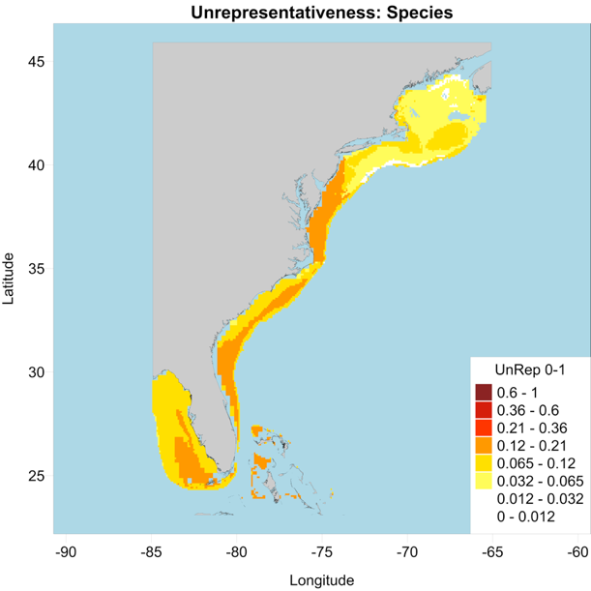
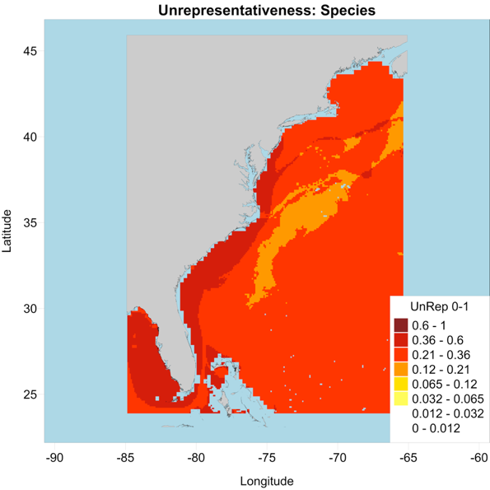
BRT Analysis and Acoustic Telemetry
Practical considerations
Receiver coverage
Limit modeling to general area of receiver coverage and similar environments
Temporal coverage
Limit modeling to time frames (months, seasons) during which tagged animals were actually detected
Summarizing data
Clipped to receiver coverage
Not clipped
Summarize to an appropriate time scale
Match to temporal resolution of explanatory variables
For satellite data, usually daily

Slide 16
BRT Analysis in R
Commonly-used packages
Dismo (Elith and Leathwick 2011)
Functions for running BRTs, mapping, diagnostic metrics, etc.
Each step is a separate function
Gbm.auto (Dedman et al. 2017)
Automates mode running, mapping, marginal effect plots, diagnostics...
Very handy, but can sometimes be tough to find sources of errors
Includes functions for running steps individually
Runs a binary BRT for presence/absence, and a Gaussian BRT for abundance (using only data where species was present)

Slide 17
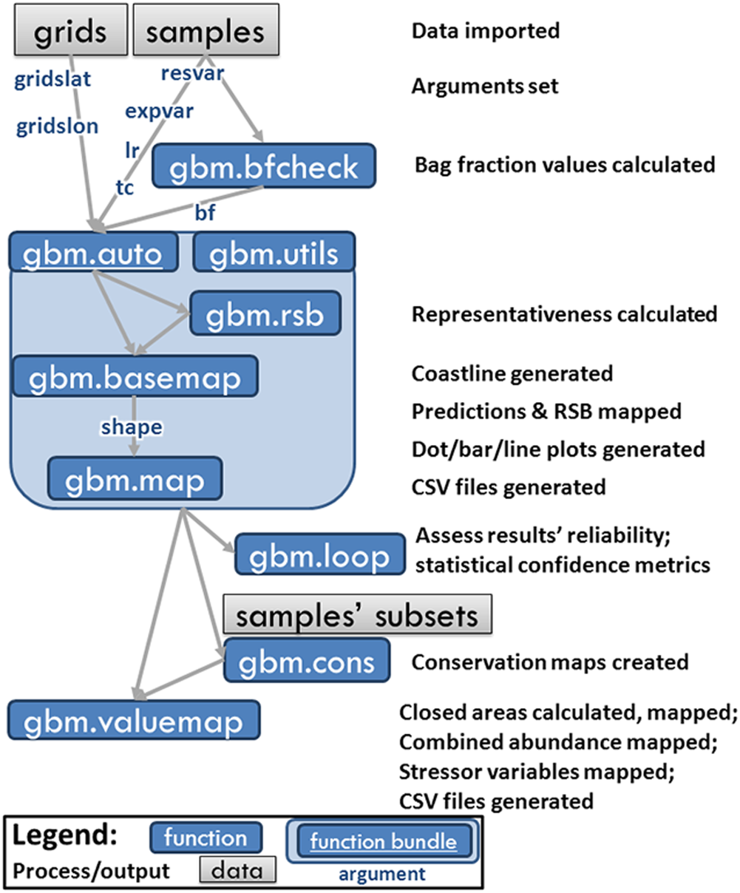
BRT Analysis in R
BRT analysis using gbm.auto and the “gbm.auto” function
Highly recommended reading:
Dedman, S., R. Officer, M. Clarke, D. G. Reid, and D. Brophy. 2017. Gbm.auto: a software tool to simplify spatial modeling and Marine Protected Area planning. PLOS One 12: e0188955.
Especially the supplementary material
Available at simondedman.com
Dedman et al. (2017)

Slide 18
BRT Analysis in R
Prepping data for a run through the “gbm.auto” function
What you’ll need:
Presence/abundance data including explanatory variables – “samples”
Gridded data of latitude, longitude, and explanatory variables – “grids”
Only needed if mapping results
Can be helpful to already have a shapefile of your study area, but one can be generated during the “gbm.auto” function

Slide 19
BRT Analysis in R
What’s in the code?
The basics
Explanatory variable columns
Response variable column
Grids data frame
Samples data frame
gbm.auto(expvar=c(5,7,8,9), resvar=10, grids=NovShelfGrid, samples=DuskyNov17, lr=0.005, bf=0.6, tc=4,
gridslat=3, gridslon=4, map=TRUE, shape=BaseMap, gaus=FALSE, varint=TRUE, simp=FALSE, max.trees=10000)
Learning rate
Bag fraction
Tree complexity
Latitude and longitude columns
Must match in both grids and samples data

Slide 20
BRT Analysis in R
What’s in the code?
Advanced options – there are more available than shown here
Do you want to map results?
If not, grids, gridslat, gridslon can be removed
Specify shoreline shapefile
gbm.auto(expvar=c(5,7,8,9), resvar=10, grids=NovShelfGrid, samples=DuskyNov17, lr=0.005, bf=0.6, tc=4,
gridslat=3, gridslon=4, map=TRUE, shape=BaseMap, gaus=FALSE, varint=TRUE, simp=FALSE, max.trees=10000)
Do you want to run the Gaussian model?
If not, only the binary presence/absence model is run
Tests whether model performs better with some variables removed
Calculate interactions between explanatory variables
Set maximum number of tree iterations to run

Slide 21
BRT Analysis in R
Choosing and testing model parameters
Can run multiple combinations of lr, bf, tc
e.g. lr=c(0.005,0.001) will run separate models for lr = 0.005 and 0.001
“gbm.auto” automatically selects best-performing combination of parameters based on CV score
General advice for choosing starting parameters
“gbm.bfcheck” function returns minimum bf values for binary and Gaussian models that will allow them to run
Lower lr values generally provide less variability in model results, but can also take much longer to run
High tc values in cases where many explanatory variables are used may be impractical

Slide 22
BRT Analysis in R
Interpreting reports of model results
Variables
Models run
Parameters
Model metrics
Best model metrics
Variable influence
Zero-inflation test
Variables dropped/kept
- If simp=TRUE
Two strongest interactions
Explanatory Variables | Response Variables | Zero Inflated? | Bin_BRT.tc4.lr0.0075.bf0.6 | Bin_BRT.tc4.lr0.005.bf0.6 | Bin_BRT.tc4.lr0.0025.bf0.6 | Best Binary BRT | Bin_BRT_simp predictors dropped | Bin_BRT_simp predictors kept | Simplified Binary BRT stats | Best Binary BRT variables | Relative Influence (Bin) | Biggest Interactions (Bin)
Depth | Species | TRUE | trees: 1000 | trees: 1200 | trees: 2400 | Model combo: Bin_BRT.tc4.lr0.0075.bf0.6 | simp turned off | simp turned off | simp turned off | SST | 47.99867482 | SST and Sal. Size: 49.57
Chla |  |  | Training Data Correlation: 0.737218111416522 | Training Data Correlation: 0.705479212023333 | Training Data Correlation: 0.705977125037348 | Model CV score: 0.737218111416522 |  |  |  | Chla | 35.90218358 | SST and Chla. Size: 8.56
Sal |  |  | CV Mean Deviance: 0.0818320371585656 | CV Mean Deviance: 0.0794615826954027 | CV Mean Deviance: 0.0822913091736796 | Training data AUC score: 0.9719 |  |  |  | Depth | 10.70610764
SST |  |  | CV Deviance SE: 0.00599084392027356 | CV Deviance SE: 0.00614505740669313 | CV Deviance SE: 0.00486113069207683 | CV AUC score: 0.7929 |  |  |  | Sal | 5.393033962
 |  |  | CV Mean Correlation: 0.284953925487672 | CV Mean Correlation: 0.29083894202811 | CV Mean Correlation: 0.273500088714658 | CV AUC se: 0.0490395713231218
 |  |  | CV Correlation SE: 0.0793090352045057 | CV Correlation SE: 0.0740988037184598 | CV Correlation SE: 0.0692233078297898

Slide 23
Case Study: Northwest Atlantic Dusky Sharks
Bangley, C. W., T. H. Curtis, D. H. Secor, R. J. Latour, and M. B. Ogburn. 2020. Identifying important juvenile dusky shark habitat in the Northwest Atlantic Ocean using acoustic telemetry and spatial modeling. Marine and Coastal Fisheries 12: 348-363
Danielle Hall

Slide 24
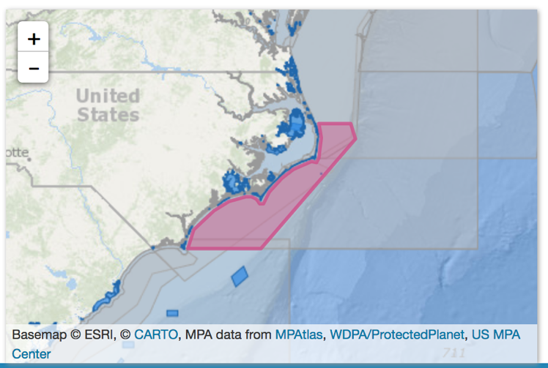
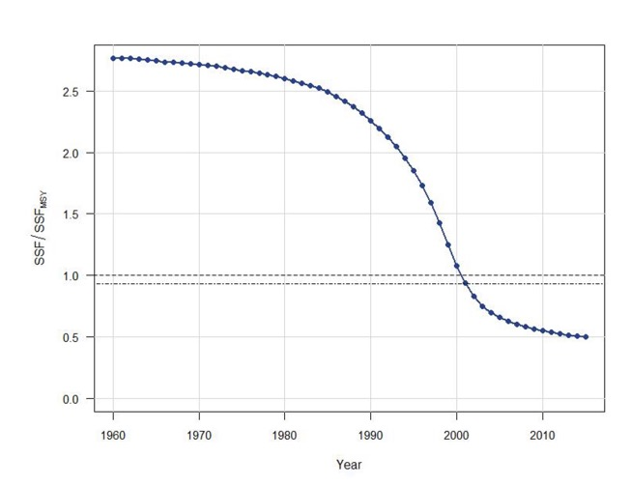
Case Study: Northwest Atlantic Dusky Sharks
Dusky Shark (Carcharhinus obscurus)
Worldwide
Northwest Atlantic
NMFS – overfished with overfishing occurring (SEDAR 2016)
Notes:
IUCN red list designations – Northwest Atlantic is us
NMFS designations – overfished = populations is below target stock threshold, overfishing occurring = fished at a rate to keep population below stock threshold
Graph shows biomass loss
Map shows Mid-Atlantic Shark Closure – closed to bottom longline gear Jan-June to protect juvenile Dusky Sharks

Slide 25
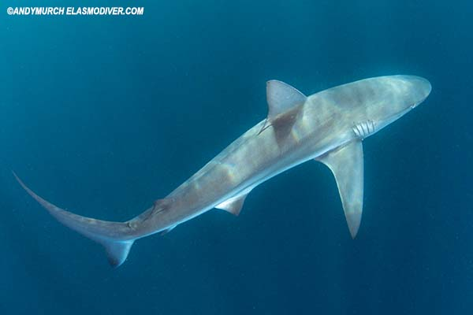
Case Study: Northwest Atlantic Dusky Sharks
Objectives
Develop spatial models of Dusky Shark presence probability based on telemetry detections and environmental data.
Account for seasonal/migratory changes in distribution.
Use spatial models to predict distribution during periods of low/no tag detection.

Slide 26
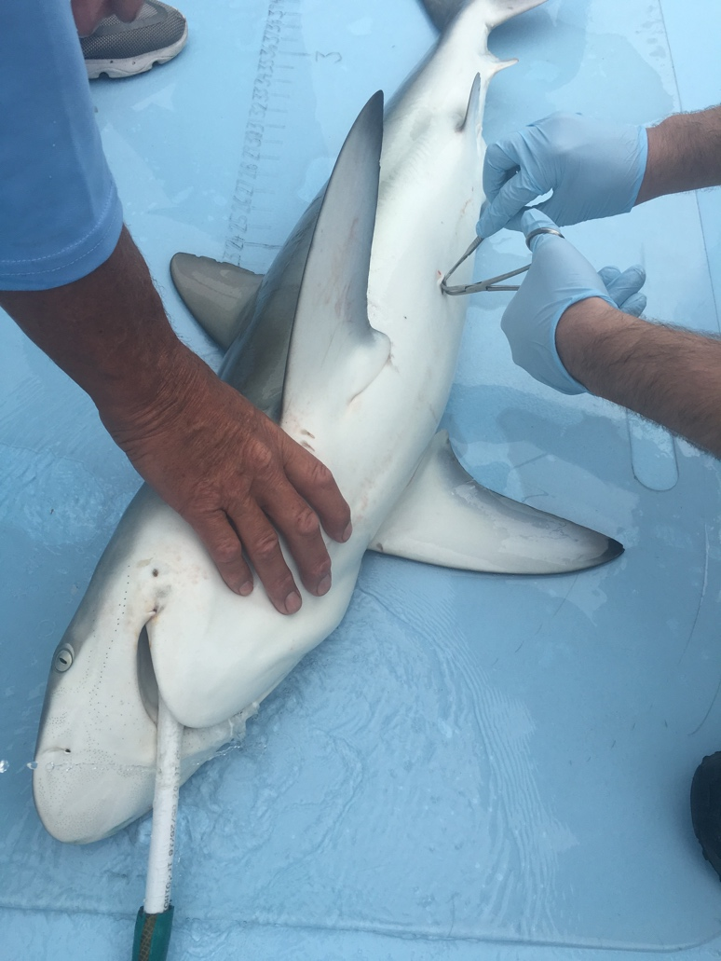
Case Study: Northwest Atlantic Dusky Sharks
Methods - Telemetry
23 Dusky Sharks
5 by VIMS off VA – Sept 2016, Aug 2017
3 by Tobey Curtis/OCEARCH off NY Bight – Sept 2016
15 off Ocean City, MD – Sept 2017
1067-2200 mm total length
Danielle Hall

Slide 27
Case Study: Northwest Atlantic Dusky Sharks
Methods - Mapping, Modeling, and Mapping
Matrix of daily presence/absence of tagged dusky sharks at each receiver
Daily environmental data extracted at receiver locations from ERDDAP products:
Depth (m) – ETOPO1
SST (°C) – MODIS Aqua
Chl a (mg/m³) – MODIS Aqua
Sal (psu) - SMAP
Seasonal and monthly (fall 2017) models
VIMS
R Packages:
rerddapXtracto – data extraction
gbm.auto – BRT modeling
Notes:
ETOPO1 Global Relief Model

Slide 28
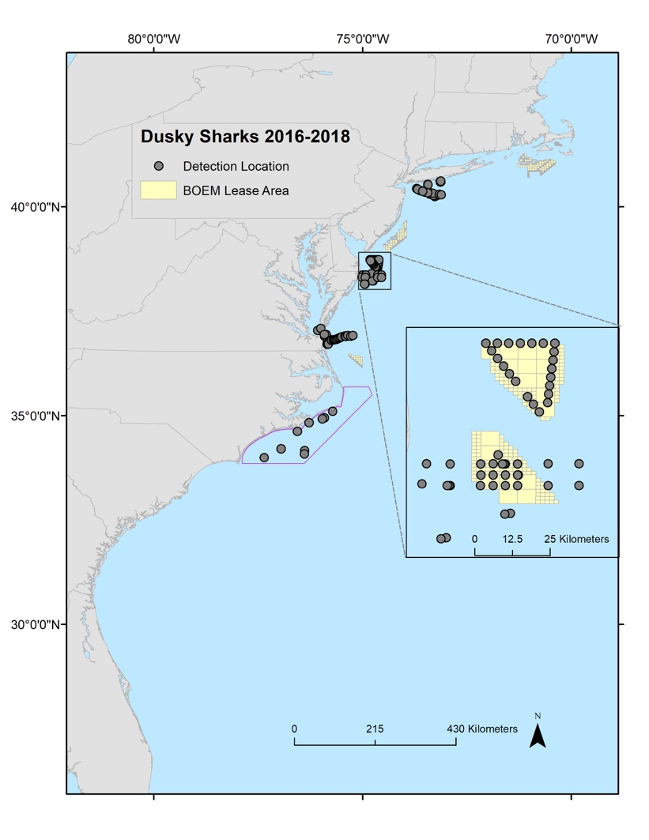
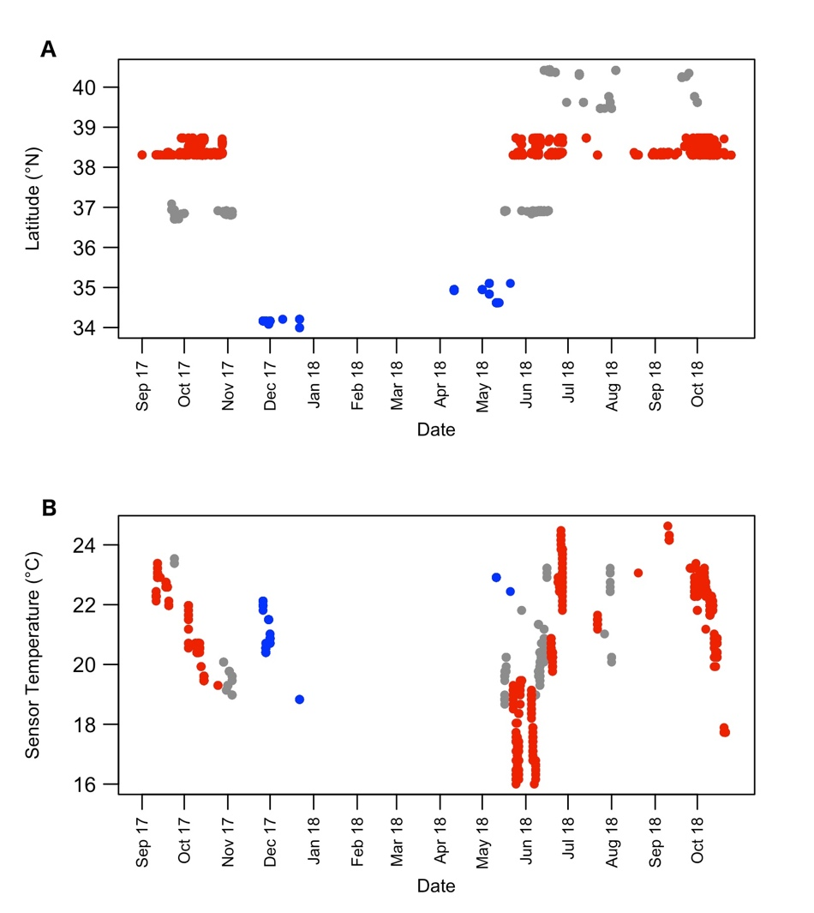
Case Study: Northwest Atlantic Dusky Sharks
Results – Tag Detections
Within BOEM Lease Areas
Within Shark Closure

Slide 29
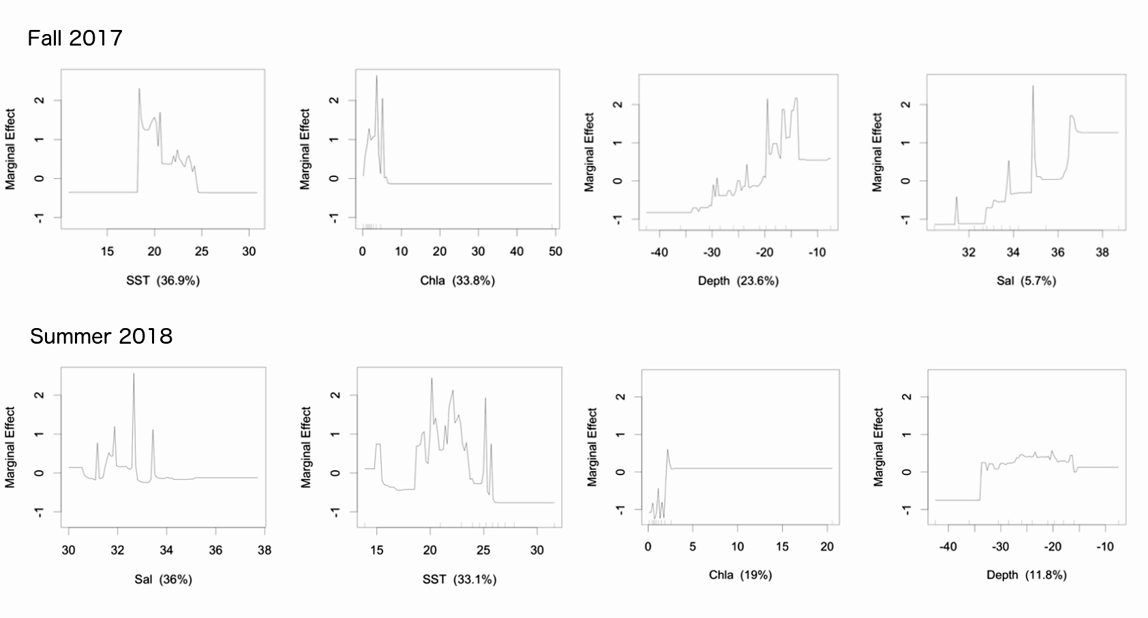
Case Study: Northwest Atlantic Dusky Sharks
Marginal effect plots – seasonal models

Slide 30
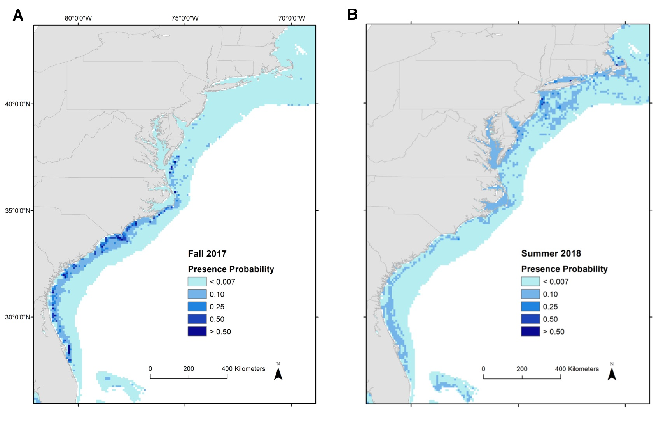
Case Study: Northwest Atlantic Dusky Sharks
Mapped model results – seasonal models

Slide 31
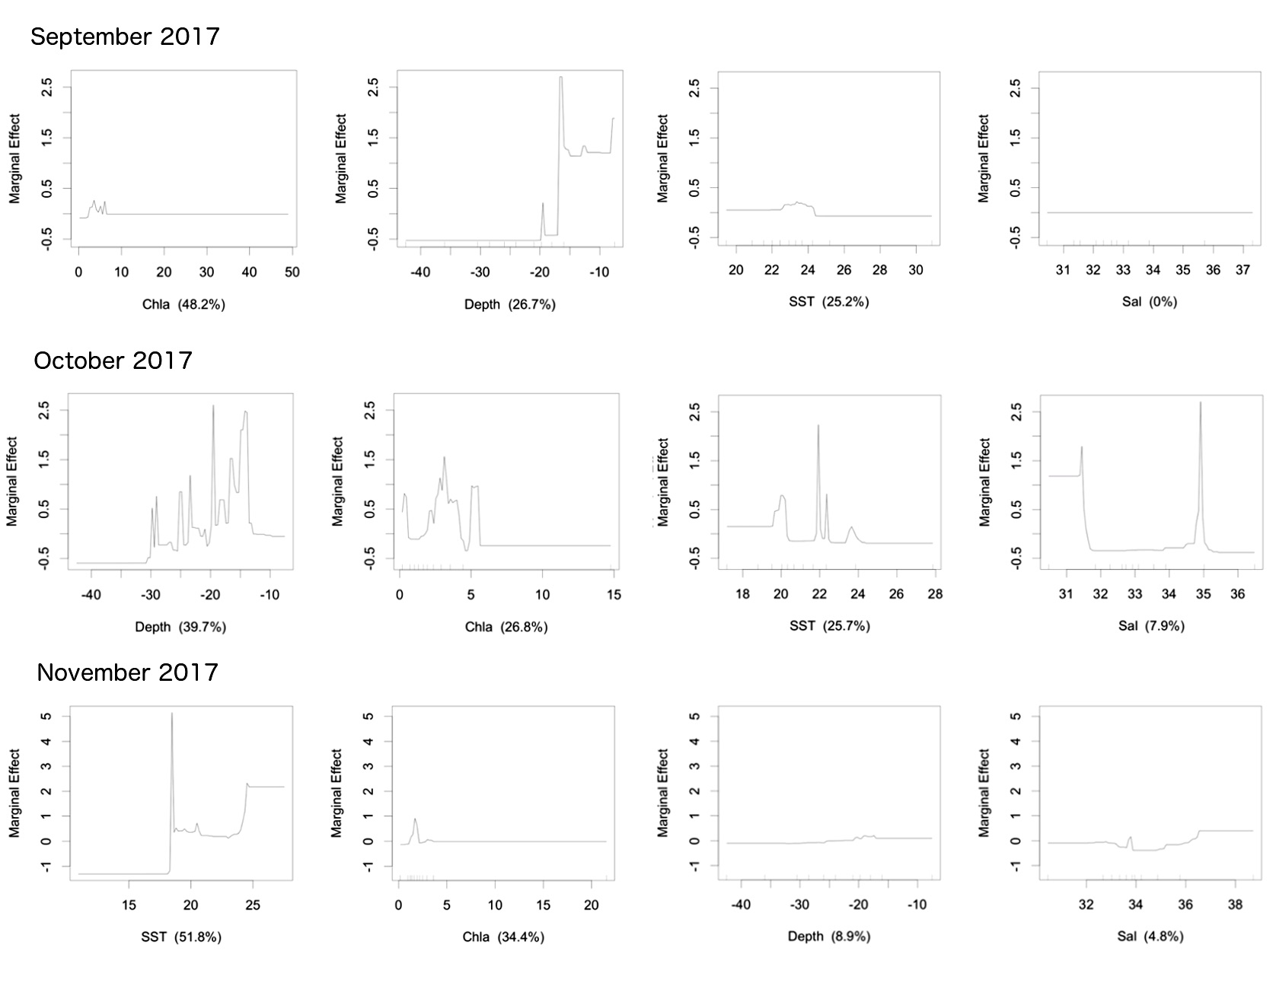
Case Study: Northwest Atlantic Dusky Sharks
Marginal effect plots – monthly models

Slide 32
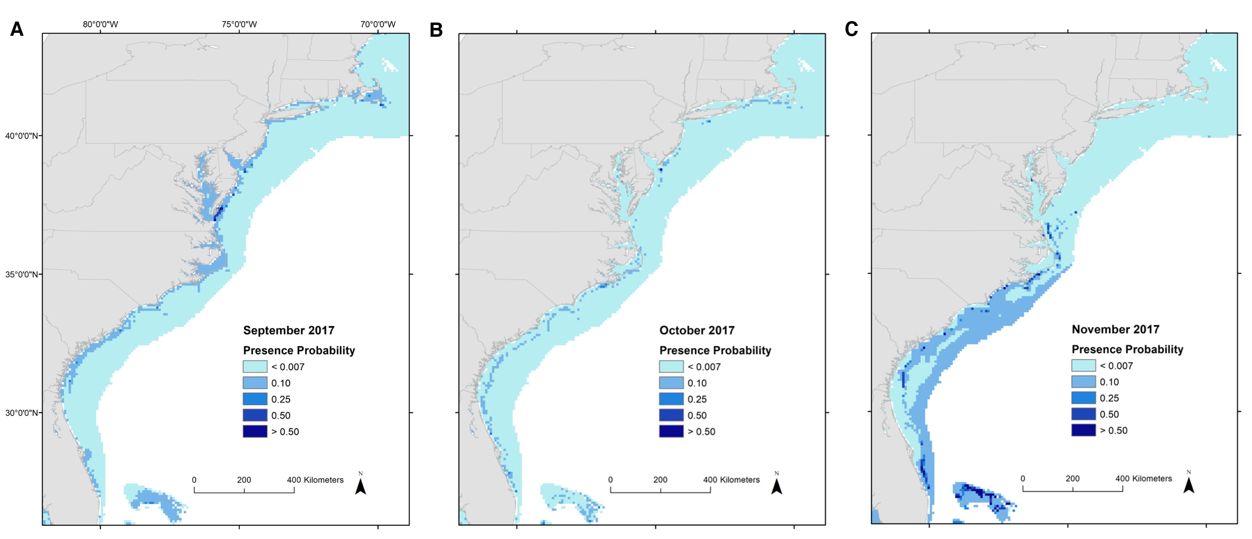
Case Study: Northwest Atlantic Dusky Sharks
Mapped model results – monthly models

Slide 33
References and Recommended Reading
Bangley, C. W., L. Paramore, S. Dedman, and R. A. Rulifson. 2018. Delineation and mapping of coastal shark habitat within a shallow lagoonal estuary. PLOS ONE 13:e0195221.
Bangley, C. W., T. H. Curtis, D. H. Secor, R. J. Latour, and M. B. Ogburn. 2020. Identifying important juvenile dusky shark habitat in the Northwest Atlantic Ocean using acoustic telemetry and spatial modeling. Marine and Coastal Fisheries 12: 348-363
Elith, J., J. R. Leathwick, and T. Hastie. 2008. A working guide to boosted regression trees. The Journal of Animal Ecology 77:802–13.
Elith, J., and J. R. Leathwick. 2011. Boosted regression trees for ecological modeling. 22pp.
Dedman, S., R. Officer, D. Brophy, M. Clarke, and D. G. Reid. 2015. Modelling abundance hotspots for data-poor Irish Sea rays. Ecological Modelling 312:77–90.
Dedman, S., R. Officer, M. Clarke, D. G. Reid, and D. Brophy. 2017. Gbm.auto: a software tool to simplify spatial modeling and Marine Protected Area planning. PLOS One 12: e0188955.
Drymon, J. M., S. Dedman, J. T. Froeschke, E. A. Seubert, A. E. Jefferson, A. M. Kroetz, J. F. Mareska, and S. P. Powers. 2020. Defining sex-specific habitat suitability for a northern Gulf of Mexico shark assemblage. Frontiers in Marine Science 7: 35.
Froeschke, J., G. Stunz, and M. Wildhaber. 2010. Environmental influences on the occurrence of coastal sharks in estuarine waters. Marine Ecology Progress Series 407:279–292.
Grubbs, R. D., and J. A. Musick. 2007. Spatial delineation of summer nursery areas for juvenile sandbar sharks in Chesapeake Bay, Virginia. Pages 63–85 in C. T. McCandless, N. E. Kohler, and H. L. Pratt, Jr., editors. Shark nursery grounds of the Gulf of Mexico and the east coast waters of the United States. American Fisheries Society Symposium 50. American Fisheries Society, Bethesda, MD.

Slide 34
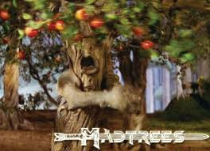
Questions?

